Slide 1
Bitcoin as a platform [various applications]

Slide 2
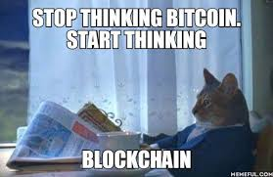

On top of bitcoin
communication overlays
commitments
token-tracking
multiparty lotteries
public randomness
prediction markets
1

Slide 3
Append-only log
tamper-evident
write-only
secure ordering
hash pointers
1

Slide 4
Secure timestamping
prove knowledge of value x at time t
without revealing x
permanence
H(x) or H(r||x)
proof of knowledge
proof of receipt
copyright / patents
time-sensitive applications
clairvoyance
2

Slide 5
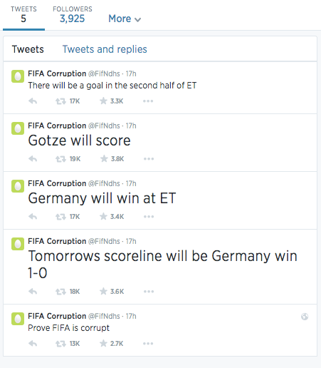
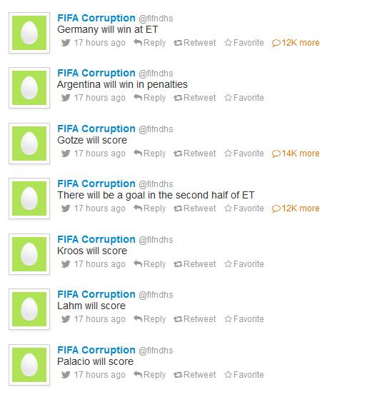
Proof of clairvoyance
commit to multiple outcomes
reveal only winning outcomes
proof of timestamping?
endless chain
3
Notes:
-2014, final match of World Cup
-Germany would win in extra time
-Gotze would score
-to prove clairvoyance you must also be able to prove that you are stamping one prediction rather than hundreds – how?
-green addresses!

Slide 6
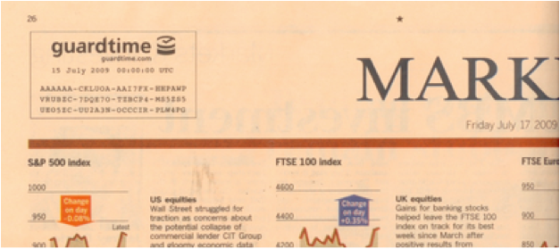
Offline timestamping
4

Slide 7
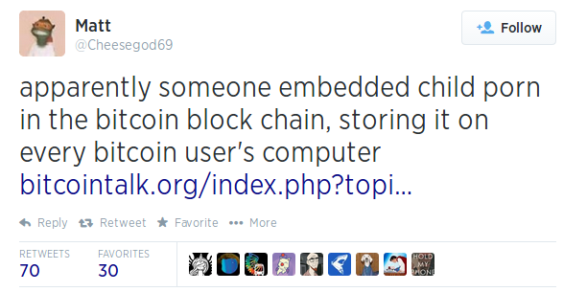
abuse
illegal content
‘grief’ the community
no easy prevention
5
Notes:
-goal is to make it dangerous to download the blockchain on your hard-drive

Slide 8
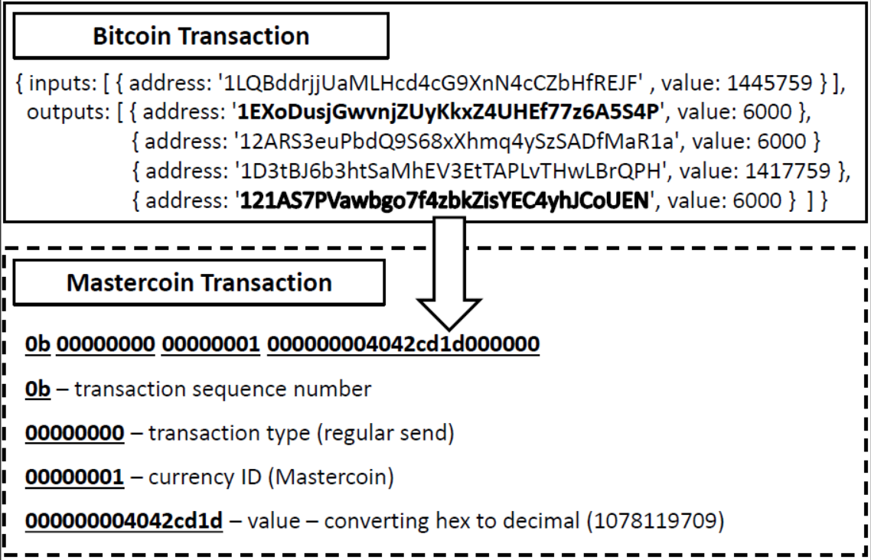
Overlay currencies
use Bitcoin as a tamper-evident log
unspendable outputs, OP_RETURN
no new mining/consensus infrastructure
miners don’t care
rules
complicated new logic
Mastercoin / Counterparty
6

Slide 9
Overlay currencies
much larger and rich feature-set
no infrastructure/bootstrapping headache
focus on progress!
faster development
Bitcoin reliance!
wasteful, e.g. UTXO bloat
inefficient
validation!
double-spends!
SPV?
7
Notes:
-in 2014, 0.5 to 1% of all BTC transactions carried Counterparty data
-Bitcoin reliance can be problematic
-Bitcoin might be blocked
-some fixed constraints – e.g. block delays, block size, etc.
-pollute Bitcoin
-inefficient in that overlay currency nodes may need to do extra processing

Slide 10
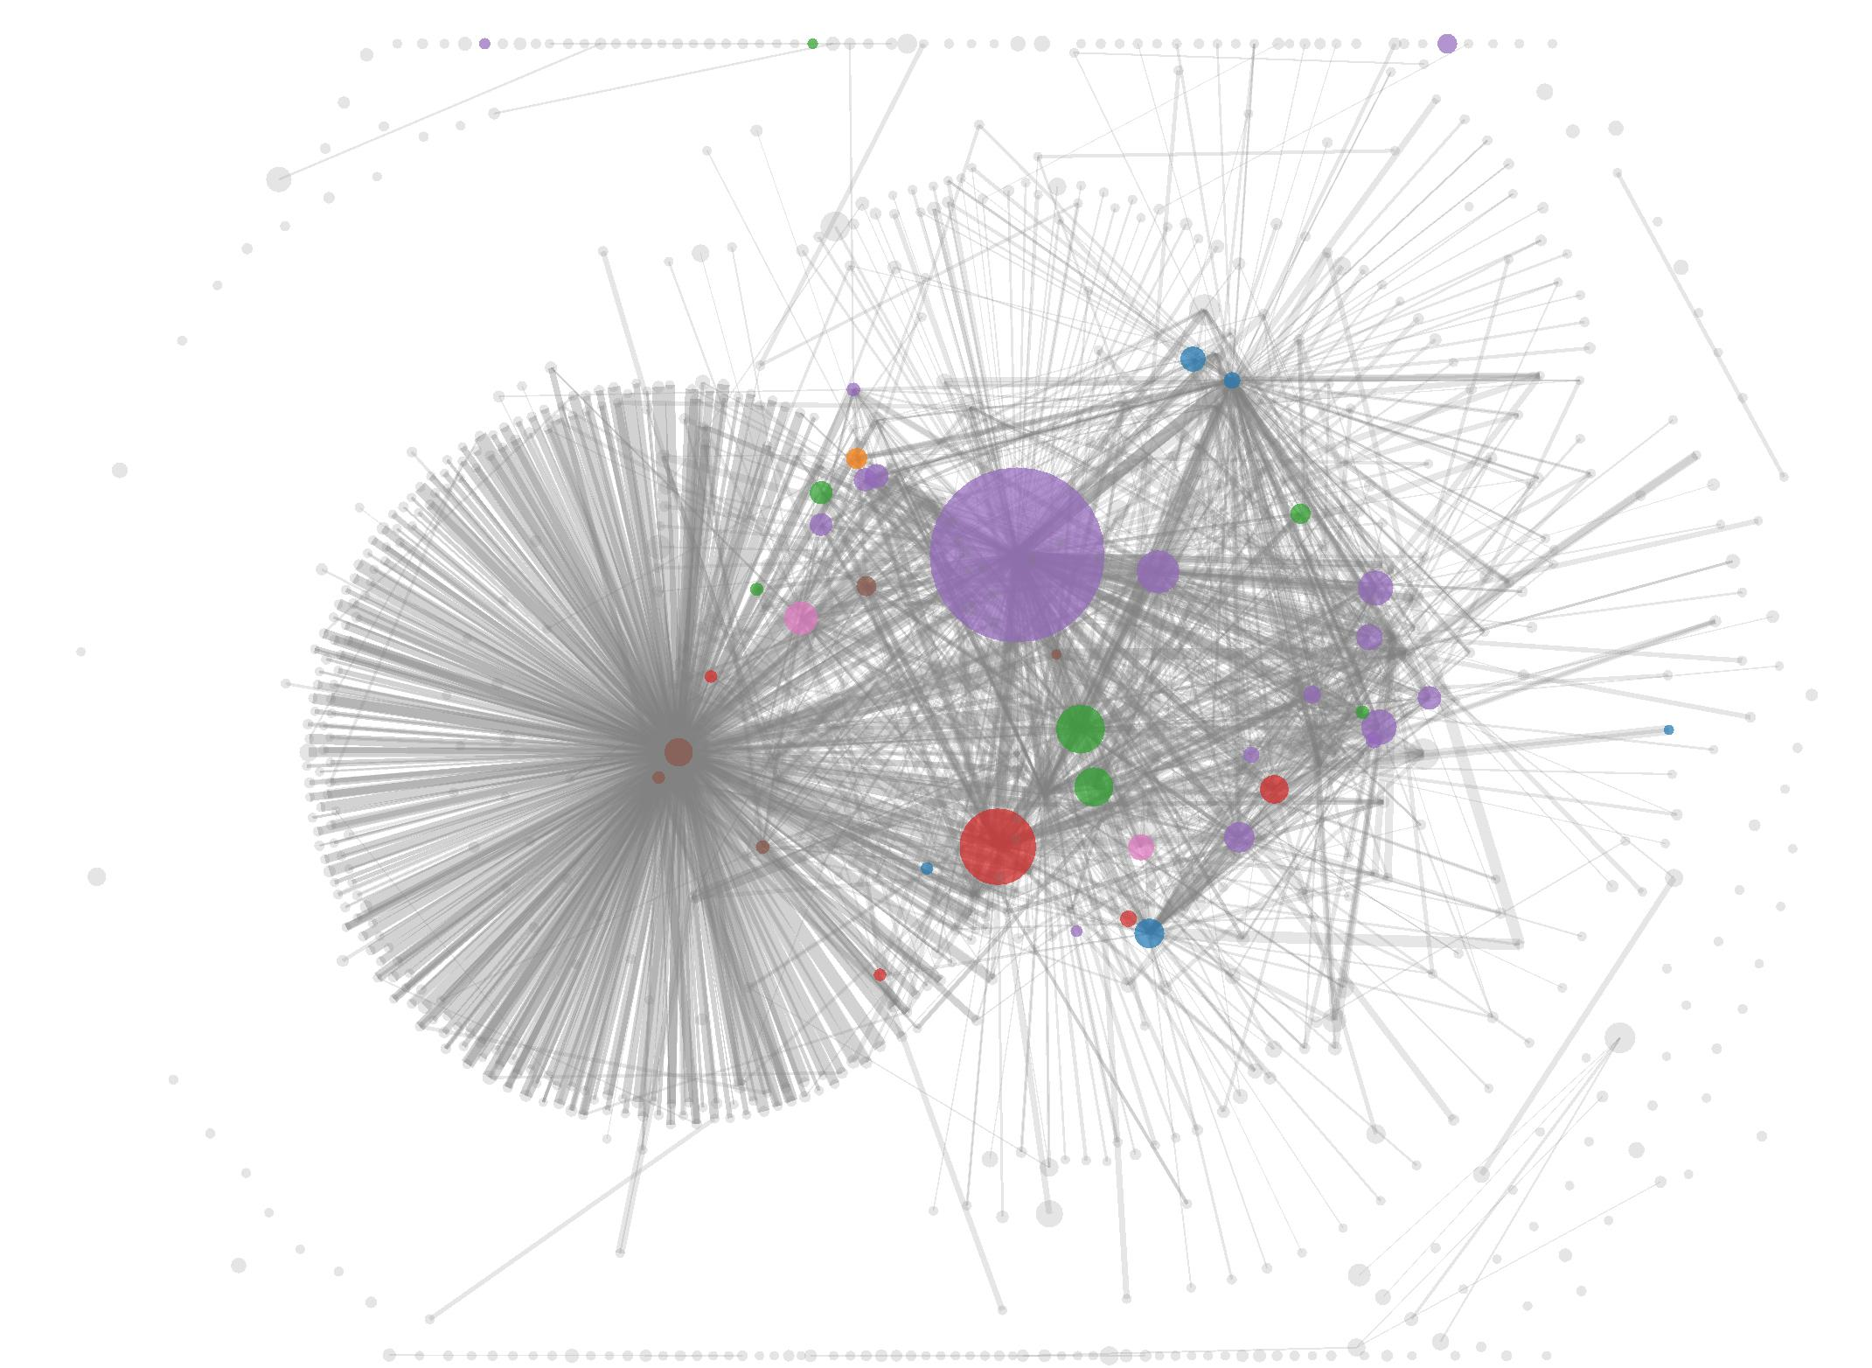
Smart property
what is a bitcoin?
unspent transaction outputs
public key hash + balance
traceability
coinbase origin
anonymity headache
8
Notes:
-every coin can be traced back to a coinbase transaction

Slide 11


Smart property
fungibility
interchangeable
gold, silver, etc.
every bitcoin has a unique and different history!
your BTC vs. my BTC?
is this property useful?
application: tainted coins
Coinbase
Coinbase
9

Slide 12
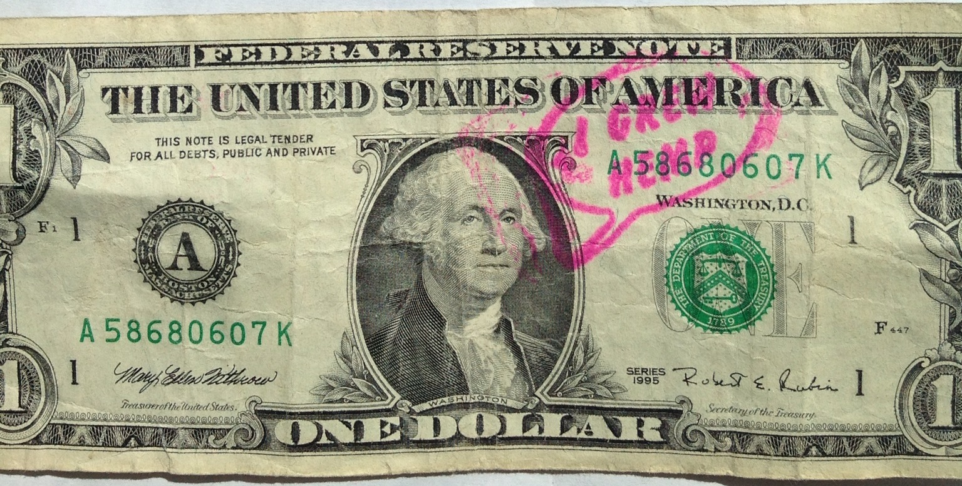
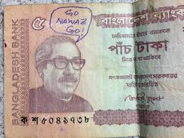
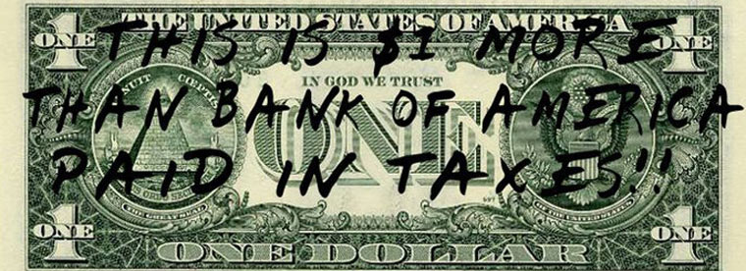
Metadata to currency
10

Slide 13
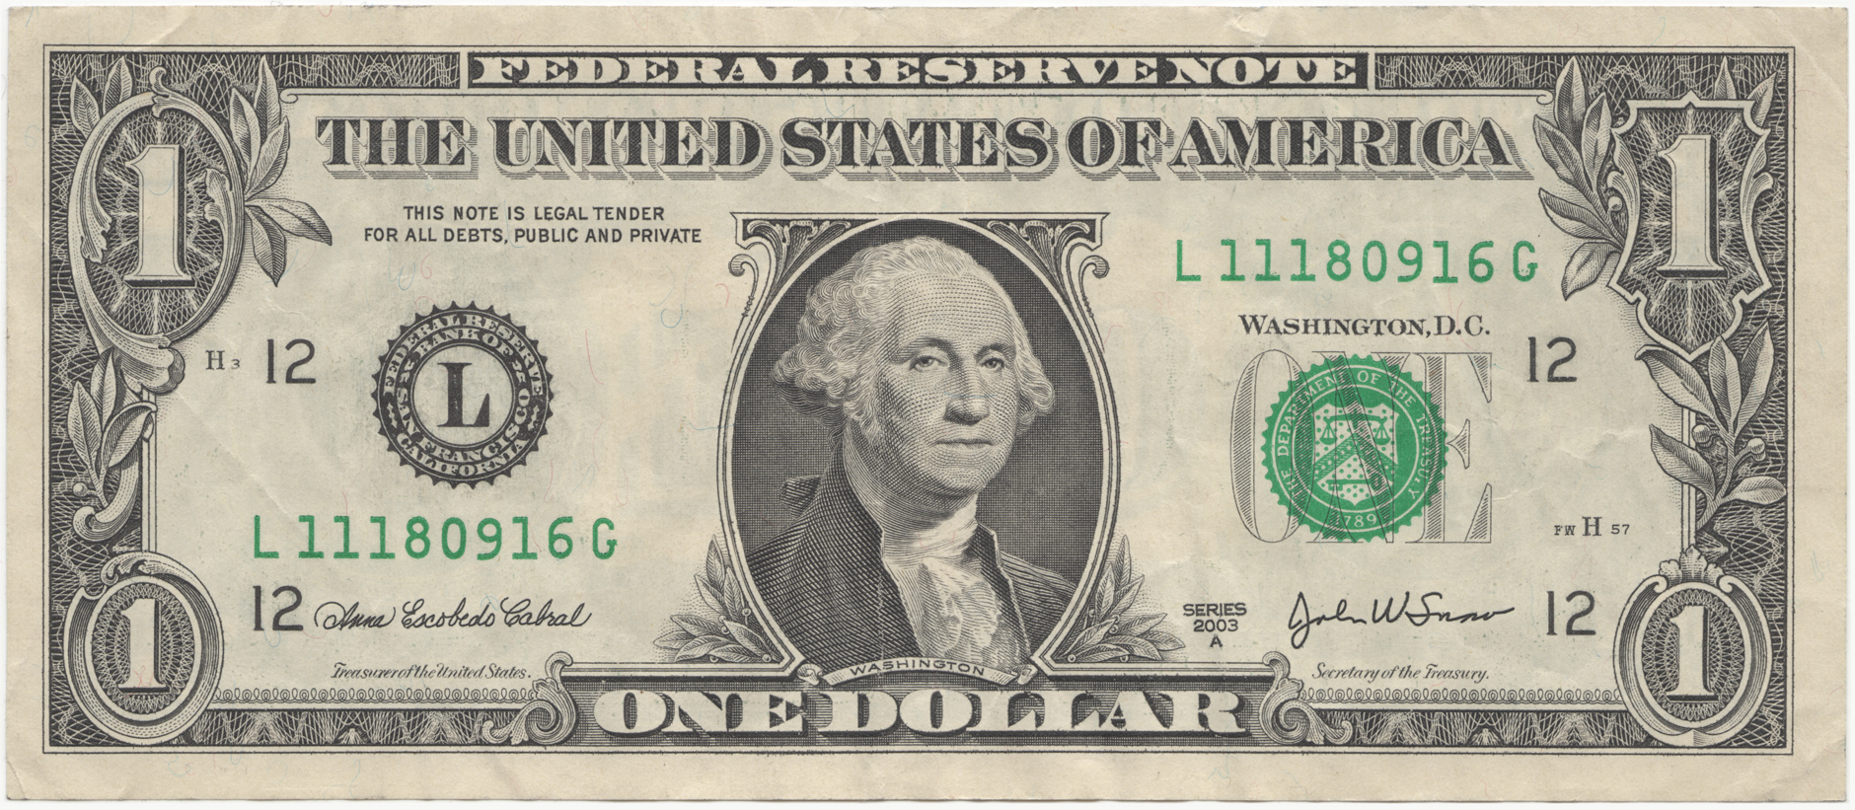
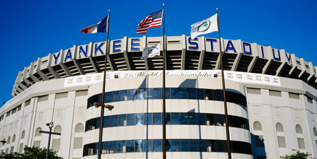

Metadata for currency
‘authenticated’ metadata on currency?
crypto signature metadata tied to serial # of note
application – baseball tickets!
“Bill #L11180916G hereby grants the holder admission to the Yankees game on Aug 18, 2014”
SIGN_{K}(M, #)
Stadium
11
Notes:
-dollar bill with a specific serial number now represents a ticket to a specific game and specific seat
-bill could be distributed in same way as paper tickets, e.g. mailed to fans when they buy a ticket online
-whoever is holding the note can enter the stadium, sit in the seat, and watch the game, no questions asked
-M could include game date, seat number, serial number of bill
-alternatively, stadium could maintain a list of serial numbers and corresponding seat numbers for every game
-2D barcodes could be used to encode the information

Slide 14
Smart property
currency can now represent different things!
anti-counterfeiting property inherited by default
note maintains its value
some users may not understand or care
new meaning relies on trust in issuer (i.e. Yankees)
physical stamp may not be necessary
new ecosystem
issuer’s rules
database
on Bitcoin?
12

Slide 15


Coloured coins
12
ISSUE 4
ISSUE 5
4
9
5
7
4
5
9
ISSUE 9
3
1
9
5
13
13
Notes:
-stamp a bitcoin with a specific colour
-coloured coins issued in ISSUE transactions
-issuer inserts extra metadata in transaction which declares some of the outputs to have a specific colour
-coloured coins can be divided, shuffled, combined, etc. just like in normal transactions
-coins can also have more than one colour

Slide 16
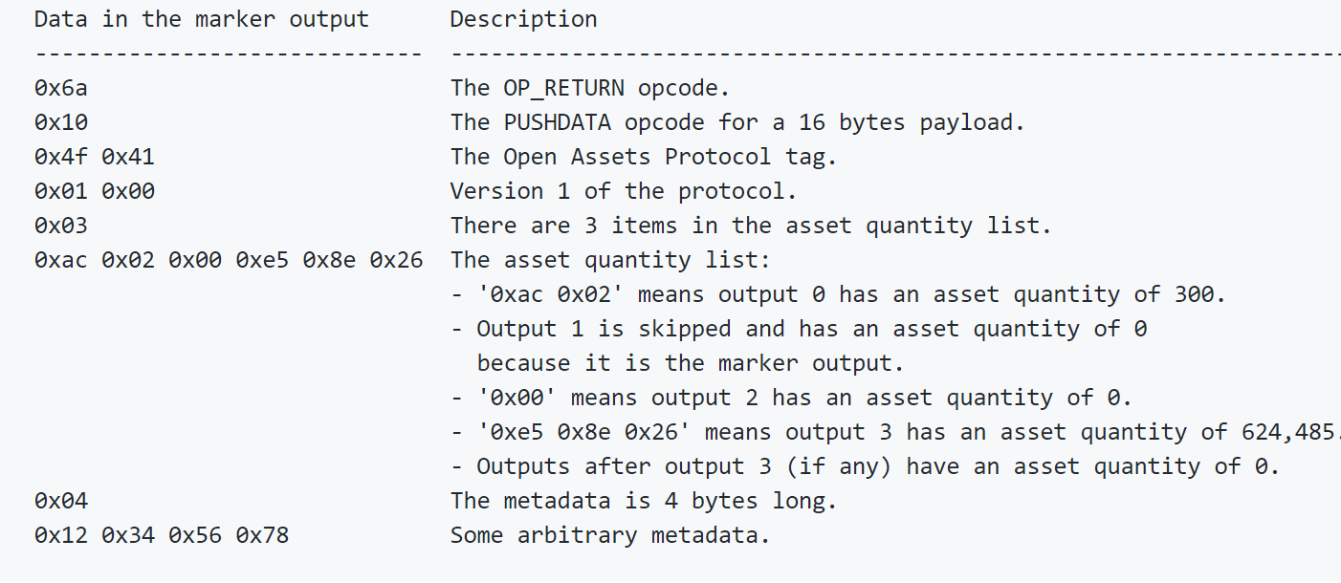
Coloured coins
issue transaction – coin passed through P2SH transaction
issuer declares address with an exchange
special marker output
Bitcoin compatibility?
decentralization
disadvantages?
transaction types:
Issue
Transfer
14
Notes:
-special marker output is a provably unspendable output
-contains metadata about how incoming colour value is divided among outputs
-decentralization – anyone can issue and transfer coloured coins
-main disadvantage – unspendable output – UTXO bloat
-second disadvantage – miners do not validate coloured coins

Slide 17
Coloured coins - applications
stocks
physical property
domain names
Namecoin
15
Notes:
-stocks – company wishing to issue coloured coins as stock would publicize its issuing address
-coloured bitcoins function as shares
-physical property: cars, houses, etc.
-sophisticated car tracks specific coin on blockchain and automatically starts and drives for whoever owns that coin

Slide 18

Homework
Chap 9: Bitcoin as a platform Bitcoin and Cryptocurrency Technologies: A Comprehensive Introduction
Coloured Coins: a bright future (link)
Coloured Coins Explorer (link)
OpenAssets example (link)
16

